Slide 1
2 Wheels London Social Asset Toolkit – June 2022 Ride to Work

Slide 2
2WL Toolkit 1 – Ride To Work (RTW)
Schedule for posting
.
Date | Poster Asset
13th June 2022 | No 1 Celebrating RTW
14th June 2022 | No 2 Ride to Work Day mission
15th June 2022 | No 3 Changing from cars to motorcycles
16th June 2022 | No 4 Access to bus lanes
17th June 2022 | No 5 The motorcycle way
18th June 2022 | No 6 Employers’ guide
19th June 2022 | Filter friendly poster
20th June 2022 | No 1 Celebrating RTW – Ride to Work Day itself

Slide 3
Social Media Post examples
Poster one Just one week to go until Ride to Work Day 😎 Read all about it: https://www.2wheelslondon.com/ride-to-work-day/ #2wheelslondon, #rtwfun, #ridetoworkfun
Poster two Ride To Work Day is all about spreading the good news. Commuting to work on a motorcycle, moped or scooter is affordable and fun 😁 Anyone can get involved – let’s break some records! #2wheelslondon, #rtwfun, #ridetoworkfun
Poster three We know that more and more commuters are turning to motorcycles as a better solution than the car. Find out why: https://www.2wheelslondon.com/ride-to-work-day/ #2wheelslondon, #rtwfun, #ridetoworkfun
Poster four “It is time for a consistent default access for motorcycles, just as already exists informally for pedal cycles.” 🗣 Colin Brown – MAG #2wheelslondon, #rtwfun, #ridetoworkfun

Slide 4
Social Media Post examples
Poster five Commuting? The best way is the motorcycle way 🏍 Learn why this Ride to Work Day: https://www.2wheelslondon.com/ride-to-work-day/ #2wheelslondon, #rtwfun, #ridetoworkfun
Poster six FAO bosses across the country! 📥 👉 https://www.2wheelslondon.com/ride-to-work-day/ #2wheelslondon, #rtwfun, #ridetoworkfun
Ride to Work Day Today is Ride to Work Day 🏍 Hands up if you’re getting your bike out today 🤚 #2wheelslondon, #rtwfun, #ridetoworkfun
Filter friendly “REMEMBER! Every motorcycle that filters past you… … is one less car in the queue in front of you 😎 #2wheelslondon, #rtwfun, #ridetoworkfun

Slide 5
Social Media Post examples - Bonus posts
We all care about the environment, right? 🌎 By riding to work, you will reduce carbon emissions and improve air quality in towns and cities. Find out more: https://www.2wheelslondon.com/ride-to-work-day/ #2wheelslondon, #rtwfun, #ridetoworkfun
This Ride to Work Day, we want to remind you that commuting on a motorcycle, moped or scooter is affordable and fun ✅ Find out more: https://www.2wheelslondon.com/ride-to-work-day/ #2wheelslondon, #rtwfun, #ridetoworkfun

Slide 6
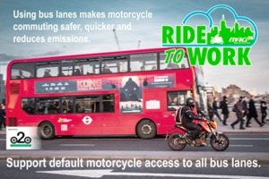
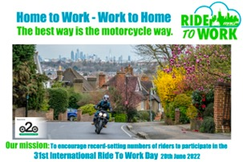
Social Assets – see accompanying files
Poster 1
Poster 2
Poster 3
Poster 4
Poster 5
Poster 6
Filter Friendly Poster
Proud to Support Image

